Slide 1

AWS Global Infrastructure

Slide 2
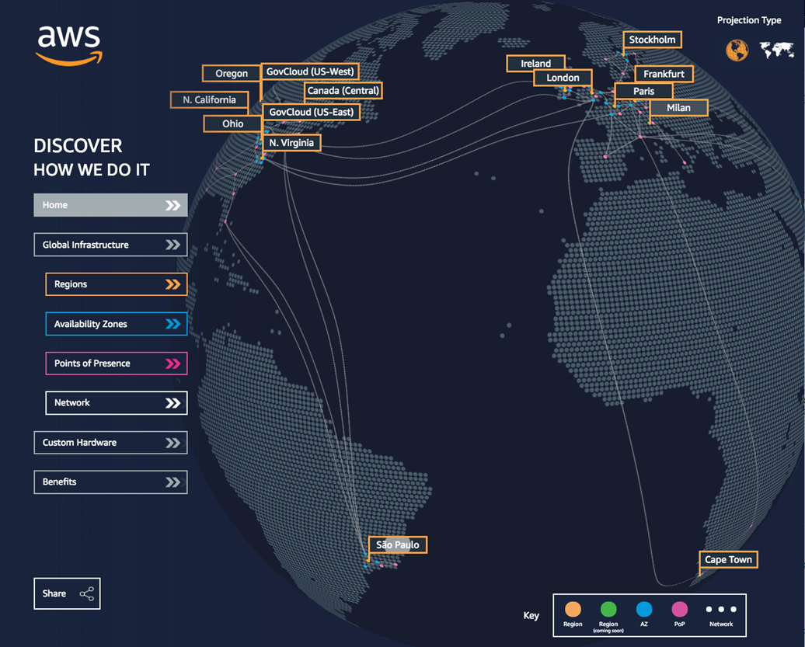
AWS Global Infrastructure
Regions
Availability Zones
Data centers
Point of presents
Global (Backbone) Network
AWS Local Zones
AWS Wavelenght
AWS Outpost
https://infrastructure.aws

Slide 3
AWS Global Infrastructure
AWS Global Infrastructure is a key technology area covered in the Cloud Practitioner exam blueprint. The AWS infrastructure is built around Regions and Availability Zones (AZs).
An AWS Region is a physical location in the world where AWS have multiple AZs.
AZs consist of one or more discrete data centers, each with redundant power, networking, and connectivity, housed in separate facilities.
Each region is completely independent. Each Availability Zone is isolated, but the Availability Zones in a region are connected through low-latency links.
AWS are constantly expanding around the world and currently there are (2021)
21 regions
66 availability zones

Slide 4
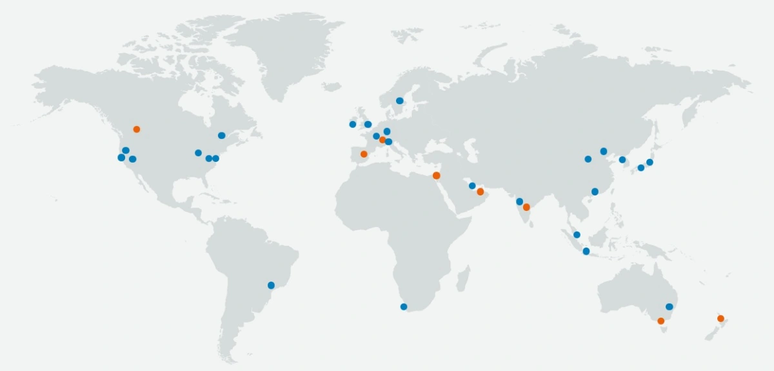
AWS Global Infrastructure : Regions
A region is a geographical area.
Each region consists of 2 or more availability zones.
Each Amazon Region is designed to be completely isolated from the other Amazon Regions.
Each AWS Region has multiple Availability Zones and data centers.
You can replicate data within a region and between regions using private or public Internet connections.
You retain complete control and ownership over the region in which your data is physically located, making it easy to meet regional compliance and data residency requirements.
Note that there is a charge for data transfer between regions.
When you launch an EC2 instance, you must select an AMI that’s in the same region. If the AMI is in another region, you can copy the AMI to the region you’re using.

Slide 5
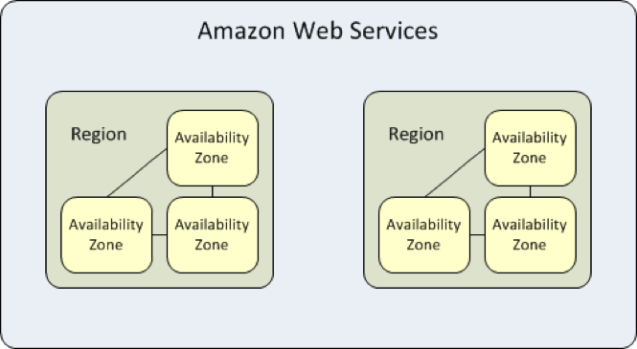
AWS Global Infrastructure : Availability Zones
Availability Zones are physically separate and isolated from each other.
AZs span one or more data centers and have direct, low-latency, high throughput and redundant network connections between each other.
Each AZ is designed as an independent failure zone.
When you launch an instance, you can select an Availability Zone or let AWS choose one for you.
If you distribute your EC2 instances across multiple Availability Zones and one instance fails, you can design your application so that an instance in another Availability Zone can handle requests.
An Availability Zone is represented by a region code followed by a letter identifier; for example, us-east-1a.
To ensure that resources are distributed across the Availability Zones for a region, AWS independently map Availability Zones to names for each AWS account.
For example, the Availability Zone us-east-1a for your AWS account might not be the same location as us-east-1a for another AWS account.
To coordinate Availability Zones across accounts, you must use the AZ ID, which is a unique and consistent identifier for an Availability Zone.
AZs are physically separated within a typical metropolitan region and are located in lower risk flood plains.
AZs use discrete UPS and onsite backup generation facilities and are fed via different grids from independent facilities.

Slide 6


AWS Global Infrastructure : Data Canters
Data centers are securely designed with several factors in mind
Each location is carefully evaluated to mitigate environmental risk.
Data centers have a redundant design that anticipates and tolerates failure while maintaining service levels.
To ensure availability, critical system components are backed up across multiple Availability Zones.
To ensure capacity, AWS continuously monitors service usage to deploy infrastructure to support availability commitments and requirements.
Data center locations are not disclosed and all access to them is restricted.
In case of failure, automated processes move data traffic away from the affected area.
AWS uses custom network equipment sourced from multiple original device manufacturers (ODMs). ODMs design and manufacture products based on specifications from a second company. The second company then rebrands the products for sale.

Slide 7
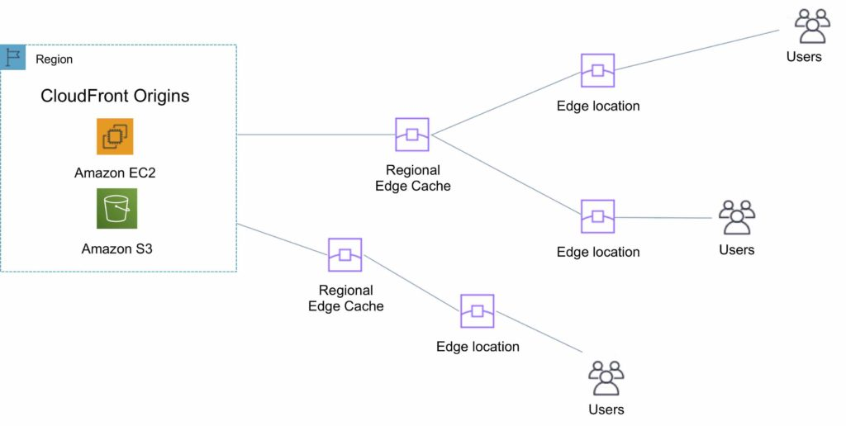
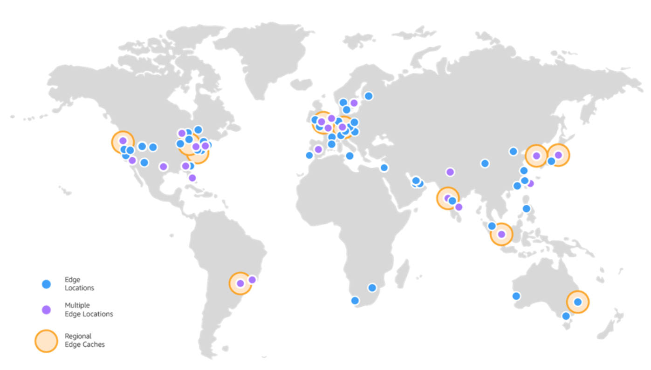
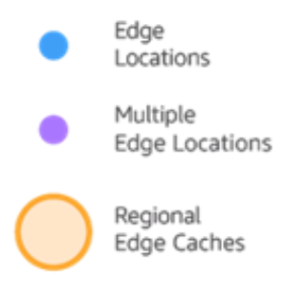
AWS Global Infrastructure : Points of Presence
AWS provides a global network of 187 Points of Presence locations
Consists of 176 edge locations and 11 Regional edge caches
Used with Amazon CloudFront
A global Content Delivery Network (CDN), that delivers content to end users with reduced latency
Regional edge caches used for content with infrequent access.
Regions and Endpoints:
When you work with an instance using the command line interface or API actions, you must specify its regional endpoint.
To reduce data latency in your applications, most Amazon Web Services
offer a regional endpoint to make your requests.
An endpoint is a URL that is the entry point for a web service.
For example, https://dynamodb.us-west-2.amazonaws.com is
an entry point for the Amazon DynamoDB service.
Notes:
Amazon CloudFront is a content delivery network (CDN) used to distribute content to end users to reduce latency. Amazon Route 53 is a Domain Name System (DNS) service. Requests going to either one of these services will be routed to the nearest edge location automatically in order to lower latency.
AWS Points of Presence are located in most of the major cities (69 cities in total) across 30 countries around the world. By continuously measuring internet connectivity, performance and computing to find the best way to route requests, the Points of Presence deliver a better near real-time user experience. They are used by many AWS services, including Amazon CloudFront, Amazon Route 53, AWS Shield, and AWS Web Application Firewall (AWS WAF) services.
Regional edge caches are used by default with Amazon CloudFront. Regional edge caches are used when you have content that is not accessed frequently enough to remain in an edge location. Regional edge caches absorb this content and provide an alternative to that content having to be fetched from the origin server.

Slide 8
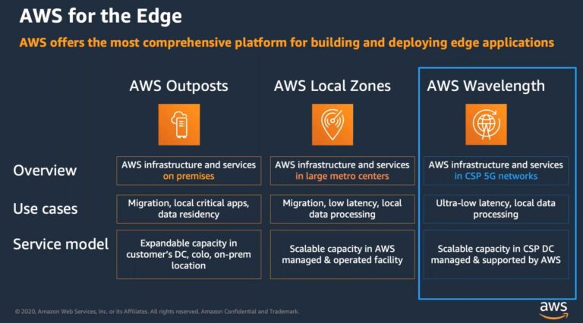
AWS Global Infrastructure : AWS for the Edge
Notes:
Amazon CloudFront is a content delivery network (CDN) used to distribute content to end users to reduce latency. Amazon Route 53 is a Domain Name System (DNS) service. Requests going to either one of these services will be routed to the nearest edge location automatically in order to lower latency.
AWS Points of Presence are located in most of the major cities (69 cities in total) across 30 countries around the world. By continuously measuring internet connectivity, performance and computing to find the best way to route requests, the Points of Presence deliver a better near real-time user experience. They are used by many AWS services, including Amazon CloudFront, Amazon Route 53, AWS Shield, and AWS Web Application Firewall (AWS WAF) services.
Regional edge caches are used by default with Amazon CloudFront. Regional edge caches are used when you have content that is not accessed frequently enough to remain in an edge location. Regional edge caches absorb this content and provide an alternative to that content having to be fetched from the origin server.

Slide 9
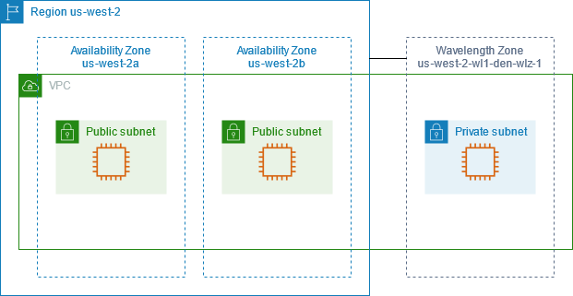
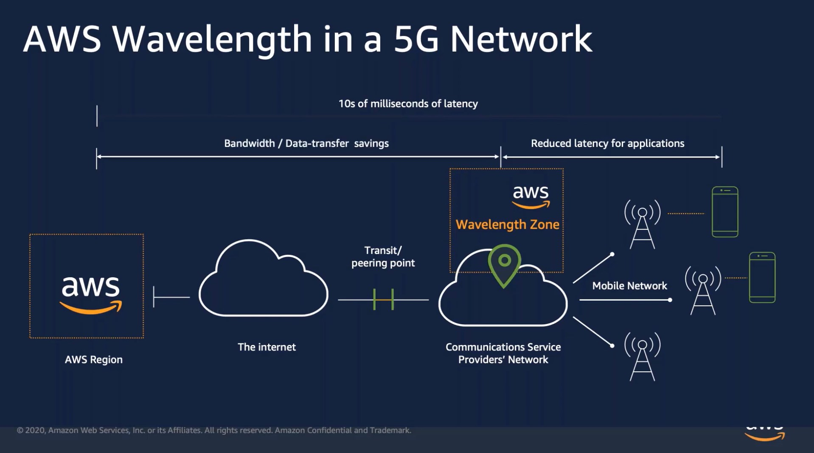
AWS Global Infrastructure : Wavelength
AWS Wavelength enables developers to build applications that deliver single-digit millisecond latencies to mobile devices and end-users.
Wavelength deploys standard AWS compute and storage services to the edge of telecommunication carriers' 5G networks. Developers can extend a virtual private cloud (VPC) to one or more Wavelength Zones, and then use AWS resources like Amazon EC2 instances to run applications that require ultra-low latency and a connection to AWS services in the Region.
A Wavelength Zone is an isolated zone in the carrier location where the Wavelength infrastructure is deployed.
Wavelength Zones are tied to a Region.
A Wavelength Zone is a logical extension of a Region, and is managed by the control plane in the Region.
This enables developers to deliver applications that require single-digit millisecond latencies such as game and live video streaming, machine learning inference at the edge, and augmented and virtual reality (AR/VR). AWS Wavelength brings AWS services to the edge of the 5G network, minimizing the latency to connect to an application from a mobile device.
Notes:
Amazon CloudFront is a content delivery network (CDN) used to distribute content to end users to reduce latency. Amazon Route 53 is a Domain Name System (DNS) service. Requests going to either one of these services will be routed to the nearest edge location automatically in order to lower latency.
AWS Points of Presence are located in most of the major cities (69 cities in total) across 30 countries around the world. By continuously measuring internet connectivity, performance and computing to find the best way to route requests, the Points of Presence deliver a better near real-time user experience. They are used by many AWS services, including Amazon CloudFront, Amazon Route 53, AWS Shield, and AWS Web Application Firewall (AWS WAF) services.
Regional edge caches are used by default with Amazon CloudFront. Regional edge caches are used when you have content that is not accessed frequently enough to remain in an edge location. Regional edge caches absorb this content and provide an alternative to that content having to be fetched from the origin server.

Slide 10
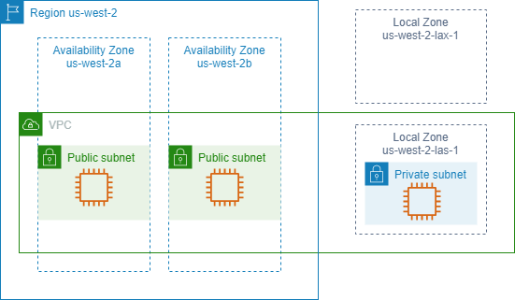
AWS Global Infrastructure : Local Zones
A Local Zone is an extension of an AWS Region in geographic proximity to your users. Local Zones have their own connections to the internet and support AWS Direct Connect, so that resources created in a Local Zone can serve local users with low-latency communications
AWS Local Zones are a type of AWS infrastructure deployment that place compute, storage, database, and other select services closer to large population, industry, and IT centers, enabling you to deliver applications that require single-digit millisecond latency to end-users.
Notes:
Amazon CloudFront is a content delivery network (CDN) used to distribute content to end users to reduce latency. Amazon Route 53 is a Domain Name System (DNS) service. Requests going to either one of these services will be routed to the nearest edge location automatically in order to lower latency.
AWS Points of Presence are located in most of the major cities (69 cities in total) across 30 countries around the world. By continuously measuring internet connectivity, performance and computing to find the best way to route requests, the Points of Presence deliver a better near real-time user experience. They are used by many AWS services, including Amazon CloudFront, Amazon Route 53, AWS Shield, and AWS Web Application Firewall (AWS WAF) services.
Regional edge caches are used by default with Amazon CloudFront. Regional edge caches are used when you have content that is not accessed frequently enough to remain in an edge location. Regional edge caches absorb this content and provide an alternative to that content having to be fetched from the origin server.

Slide 11
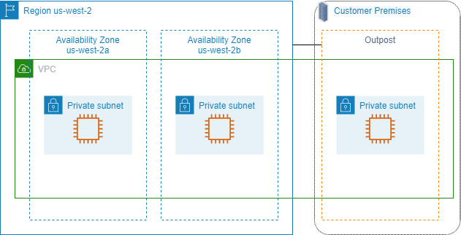
AWS Global Infrastructure : AWS Outpost
AWS Outposts is a fully managed service that extends AWS infrastructure, services, APIs, and tools to customer premises. By providing local access to AWS managed infrastructure, AWS Outposts enables customers to build and run applications on premises using the same programming interfaces as in AWS Regions, while using local compute and storage resources for lower latency and local data processing needs.
An Outpost is a pool of AWS compute and storage capacity deployed at a customer site. AWS operates, monitors, and manages this capacity as part of an AWS Region.
You can create subnets on your Outpost and specify them when you create AWS resources. Instances in Outpost subnets communicate with other instances in the AWS Region using private IP addresses, all within the same VPC.
Notes:
Amazon CloudFront is a content delivery network (CDN) used to distribute content to end users to reduce latency. Amazon Route 53 is a Domain Name System (DNS) service. Requests going to either one of these services will be routed to the nearest edge location automatically in order to lower latency.
AWS Points of Presence are located in most of the major cities (69 cities in total) across 30 countries around the world. By continuously measuring internet connectivity, performance and computing to find the best way to route requests, the Points of Presence deliver a better near real-time user experience. They are used by many AWS services, including Amazon CloudFront, Amazon Route 53, AWS Shield, and AWS Web Application Firewall (AWS WAF) services.
Regional edge caches are used by default with Amazon CloudFront. Regional edge caches are used when you have content that is not accessed frequently enough to remain in an edge location. Regional edge caches absorb this content and provide an alternative to that content having to be fetched from the origin server.

Slide 12
Where the AWS Services stands ?
AWS Global : IAM, CloudFront, Route53
Ohio Region: VPC , IGW, S3, Lambda , Dyno,oDB, Beanstalk etc.*
US-East
Oregon Region: CloudTrail, Control Tower, Direct Connect etc.
US-West
Some of the AWS services may not available in different regions
There are anywhere between two and five availability zones in an AWS Region. Moving forward, the standard will be three or more per region
N.Virgina Region: US-East
AZ-1a
AZ-1b
RDS,EC2,EBS, EFS, ELB, Snapshots, Logs etc.
AZ-1c
AZ-1d

Slide 13
Sample Questions
Q1: What is an availability zone composed of?
A. A collection of edge locations
B. A collection of VPCs
C. One or more DCs in a location
D. One or more regions
Q2: What is an AWS Region composed of?
A. Two or more Virtual Private Clouds (VPC)
B. Two or more availability zones
C. At least one availability zone
D. A collection of EC2 instances

Slide 14
Sample Questions
Q1: What is an availability zone composed of?
A. A collection of edge locations
B. A collection of VPCs
C. One or more DCs in a location
D. One or more regions
Q2: What is an AWS Region composed of?
A. Two or more Virtual Private Clouds (VPC)
B. Two or more availability zones
C. At least one availability zone
D. A collection of EC2 instances

Slide 15
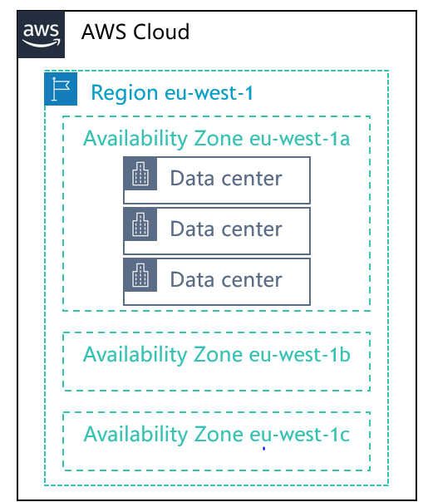
Module Summary
The AWS global infrastructure consists of Regions, Availability Zones, and edge locations
Your choice of a Region is typically based on compliance requirements or to reduce latency
Each Availability Zone is physically separate from other Availability Zones and has redundant power, networking, and connectivity
Edge locations and Regional edge caches improve performance by caching content closer to users

